Slide 1
HTML5 – Mid and Advanced
Technologies and Tools for Scalable Development
18th of September, 2013

Slide 2
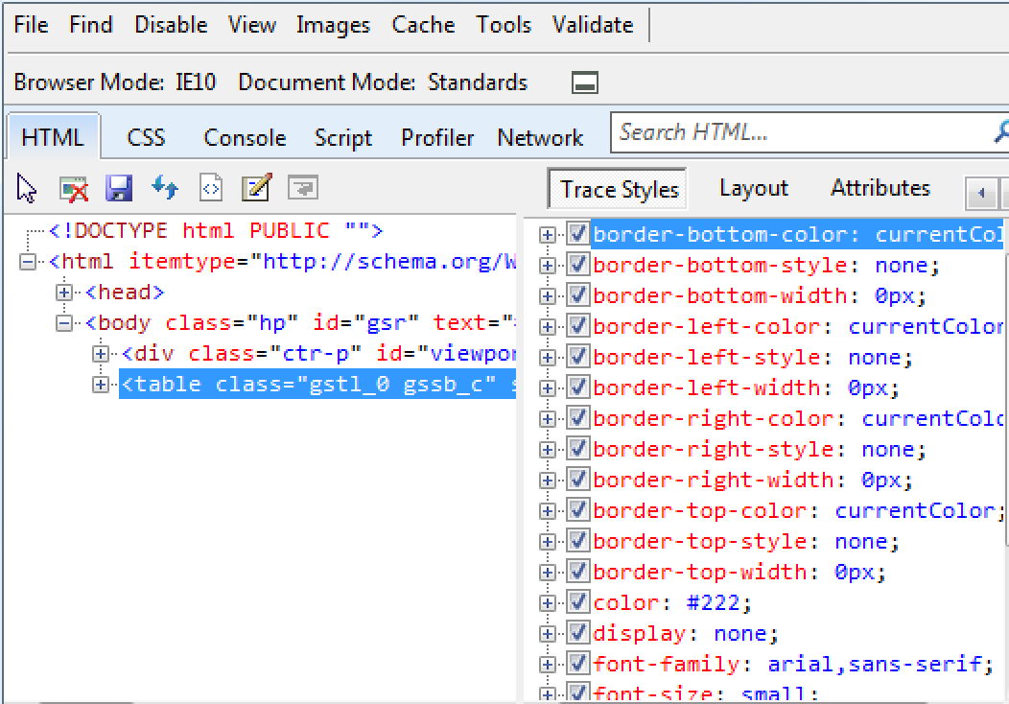
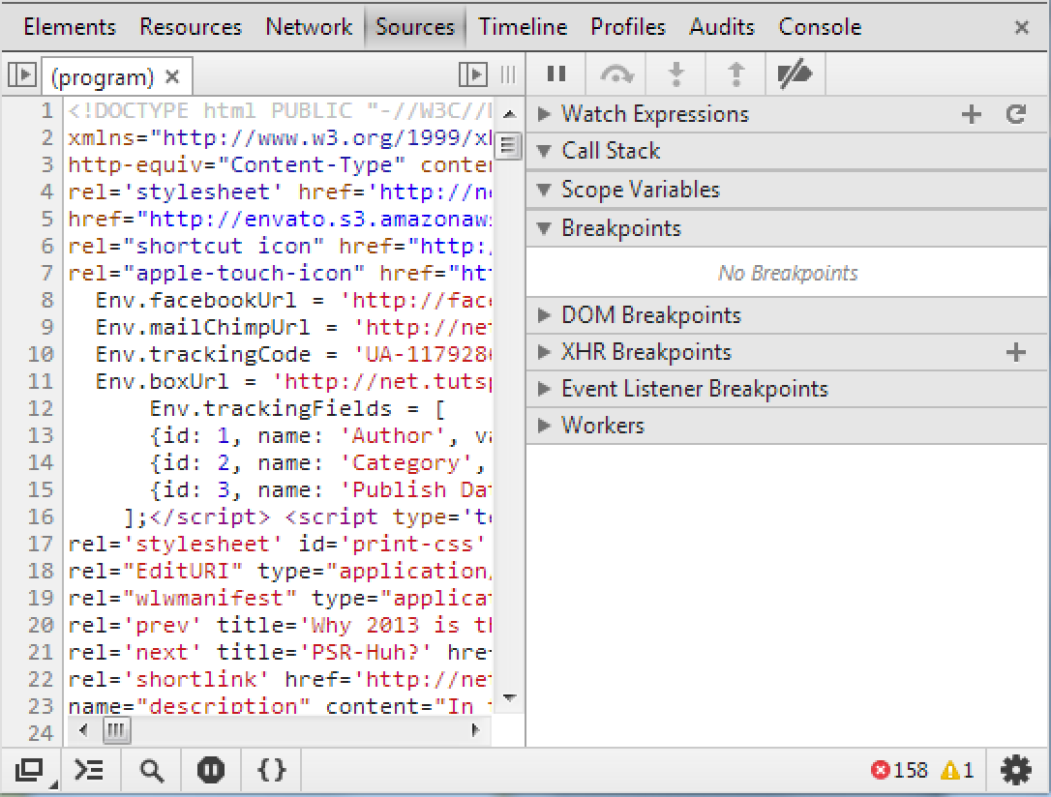
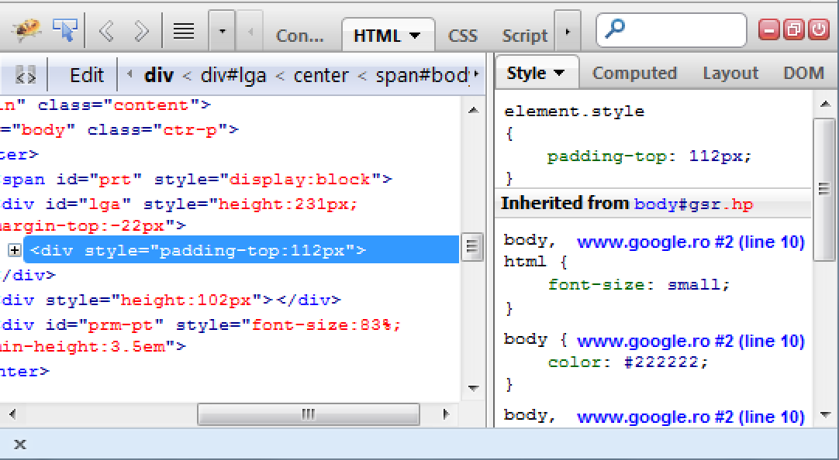
Development Tools
All the major browsers (Chrome, Firefox, Internet Explorer) have a set of web authoring and debugging tools

Slide 3
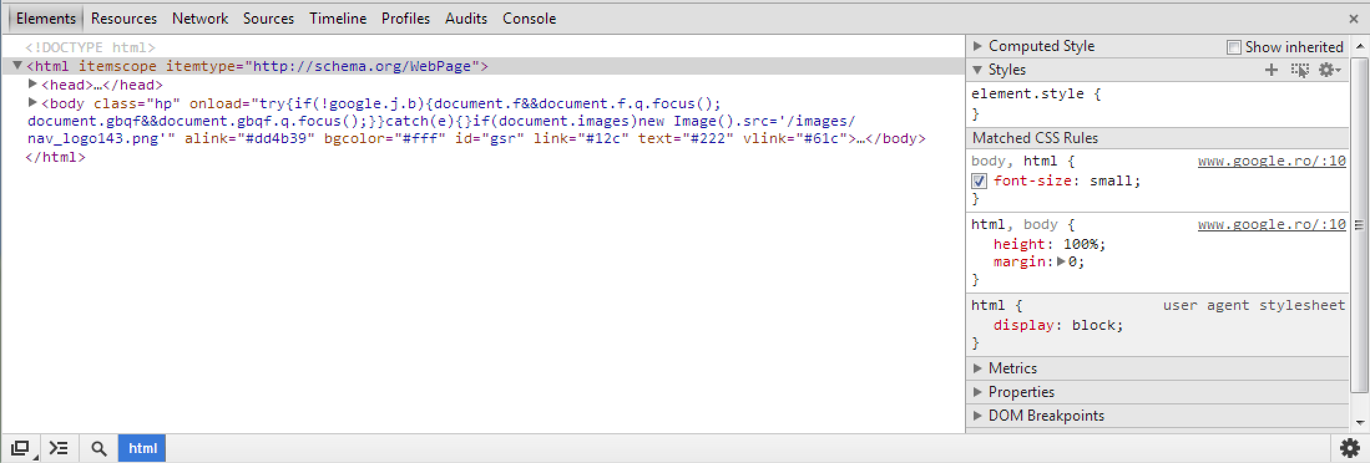
Chrome DevTools
Overall, there are eight main groups of tools available in Chrome DevTools: Elements, Resources, Network, Sources, Timeline, Profiles, Storage, Audits, and Console

Slide 4
Chrome DevTools
Useful features and commands:
- Ctrl + O -> Filter For A Script, Stylesheet Or Snippet By Filename
- Ctrl + Shift + F -> Text Search Across All Files
- Local Modifications for saved changes using DevTools
- Persistence Extension (Tincr) -> bi-directional editing
- Source Maps -> used to map combined/minified scripts (Closure Compile, UglifyJS) back to an unbuilt state for debugging;
Notes:
Source Maps: http://net.tutsplus.com/tutorials/tools-and-tips/source-maps-101/

Slide 5

Chrome DevTools
Tincr, Source Maps

Slide 6
Thank you!
Cosmin Nicula
Blog: http://cosmi.nu
GitHub: https://github.com/cosminnicula
Twitter: https://twitter.com/cosminnicula

